Slide 1
Intro to CEPH for new faculty & staff

Slide 2
Who should I contact?
Staff Contact
General questions
submissions@ceph.org
Substantive change notices
To set up a call
Interim reports
To find your staff contact

Slide 3
Terminology
Self-study
Document prepared by the unit that ensures coverage of accreditation criteria
Interim Report
Requirement when the Council finds noncompliance with accreditation criteria
Annual Report
All units must submit yearly data to CEPH online
Substantive Change
Update to CEPH of changes made within an accredited unit
Site Visit
A site visit team comes to your university to meet with faculty, students & stakeholders
Consultation Visit
Meeting with CEPH staff to clarify the accreditation process in a unit’s specific context

Slide 4
Intro to our website

Slide 7
Annual Reporting
What is it?
Each school or program creates an online user account to enter accreditation data including graduation rates, number of faculty & more
Report on data from the most recently completed academic year
Allows CEPH to monitor significant changes and ongoing compliance
When is it due?
The deadline is posted on the CEPH website, but always expect a due date in early December
We will contact you when it is time!
The ONLY exception are units that have received accreditation for the first time ever this year

Slide 8
Interim Reporting
What is it?
Documentation requirement when the Council finds noncompliance
You will be notified by email if an IR is due
When is it due?
The letter will define what is due and when

Slide 9
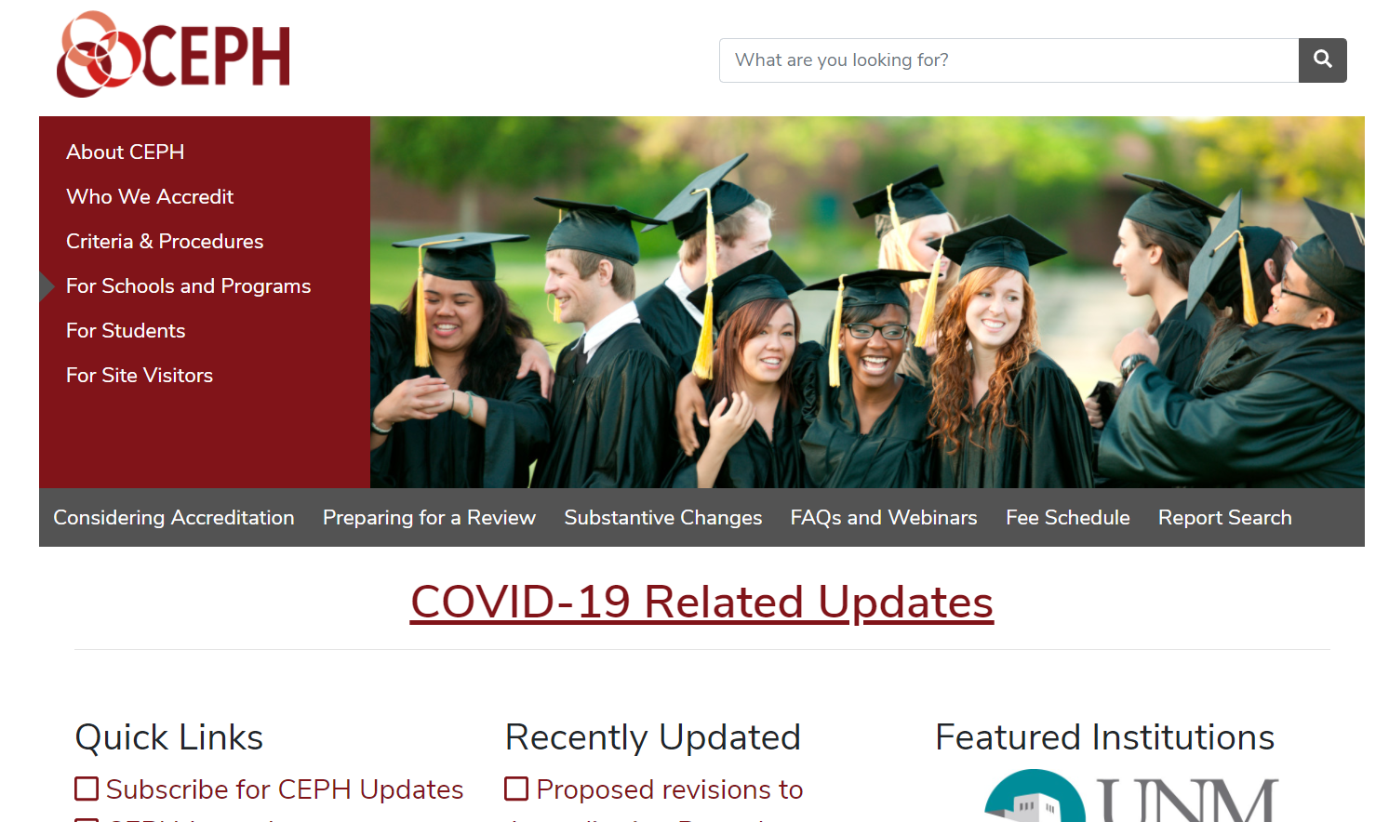

Slide 11
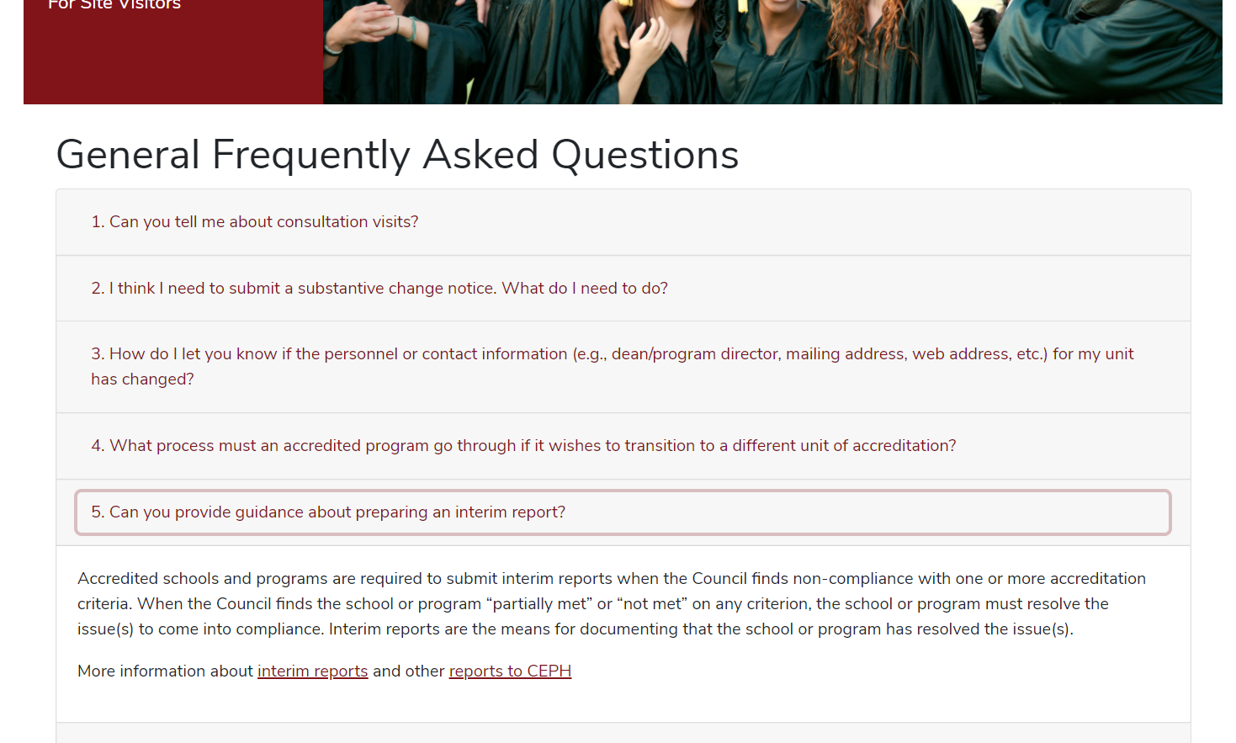

Slide 13
Substantive Changes
Notice to CEPH if:
Add an MPH or DrPH
Add a joint degree
Suspend or discontinue a degree
Rename a concentration
Add a public health bachelor’s degree
Altering curricular mapping for competencies
When to make the change?
Notify CEPH in writing before the change is implemented, but after it has been approved by the university

Slide 15
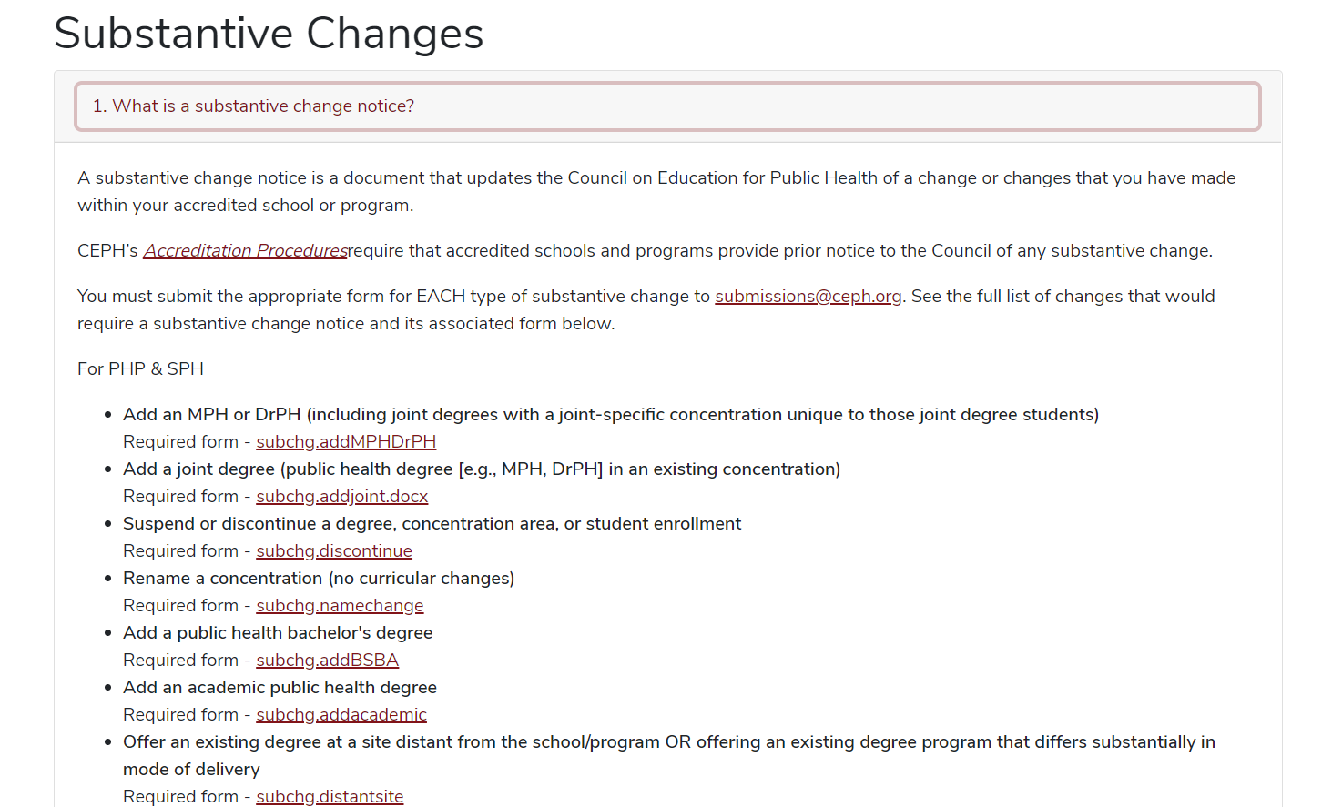

Slide 16
Next steps…
Thank you for watching!
Please make sure to follow-up with your CEPH contact person if you have any additional questions

