Slide 1
TRENDS IN PUBLIC HEALTH HIGHER EDUCATION
What is the landscape in 2020?
NOVEMBER 10, 2020

Slide 2
Welcome! Laura rasar King, CEPH Executive Director

Slide 3
AFTER THE WEBINAR
www.ceph.org/trends2020
3:30 pm ET
Today’s slides & recording
within 24 hours

Slide 4
TRENDS 2020
What it is
What it isn’t
Snapshot in time
Description & context
Landscape view
Reflective of 2020 changes
Scientific study

Slide 5
QUESTIONS AT THE END
We CAN provide
We CAN’T provide
Clarifications on anything you hear in the webinar
Info beyond the scope of the presentation

Slide 6
Phillip Williams, CEPH President

Slide 7
2016 criteria CHANGES

Slide 8
FIVE CORE AREAS
Biostatistics (BIOS)
Environmental Health Sciences (EHS)
Epidemiology (EPI)
Health Services Administration (HSA)
Social & Behavioral Sciences (SBS)

Slide 9
Before & After
MPH curriculum grounds students in 5 core areas
DrPH curriculum ensures grounding in 5 core areas
SPH offer MPH in 5 core areas & doctoral degrees in 3 of 5 core areas
Units write all competency statements
MPH students demonstrate knowledge & competencies
DrPH curriculum focuses on advanced practice competencies
SPH offer MPH in 3 areas & doctoral in 2 areas that meet student & workforce needs
Foundational competencies defined, units write concentration competencies

Slide 10
“Programs of study”

Slide 11
Creating the Report
Publicly available data
Limited CEPH data, e.g., substantive change trends

Slide 12
Documents & information format

Slide 14
Key takeaways: information & observations

Slide 15
Accredited units
Unit | # accredited today | # accredited December 2019
SPH | 67 | 67
PHP | 132 | 127
SBP | 18 | 16
Total | 217 | 210

Slide 16
Fast facts
Of 210 units, how many offer…
MPH | 194
Bachelor’s | 91
PhD | 73
MS | 59
DrPH | 37
Distance-based degree(s) | 89

Slide 17
Top Concentrations
MPH
SBS
EPI
HSA
PhD
EPI
SBS
EHS
MS
EPI
BIOS
EHS
Bachelor’s
General Public Health
SBS
EHS
DrPH
Practice & Leadership
SBS
HSA

Slide 18
MPH Trends

Slide 19
ACCREDITED MPH DEGREES
194 units offer accredited MPH
897 programs of study
~70% located in SPH
~30% in PHP
46% of PHP offer single program of study

Slide 20
Top 10 MPH programs of study
Concentration | # | %
SBS | 161 | 18%
EPI | 152 | 17%
HSA | 135 | 15%
EHS | 118 | 13%
BIOS | 81 | 9%
Global Health | 71 | 8%
General Public Health | 70 | 8%
Public Health Practice | 33 | 4%
Maternal & Child Health | 32 | 3%
Nutrition | 28 | 3%

Slide 21
Beyond the top 10 concentrations
Aerospace Medicine | Clinical Investigation | Dental Public Health
Emergency Preparedness | Ethics | Exercise & Health
Genetics | Aging | Health Communication
Health Equity | Health Informatics | Laboratory Sciences
Mental Health | One Health | Parks & Recreation
Sustainable Development | Tropical Public Health | Veterinary Public Health

Slide 22
MPH Curriculum Design Categories
Curriculum A
Discrete courses in all 5 former core areas
Curriculum B
Curriculum C
2 or fewer discrete courses in former core areas
No other courses required of all MPH students
Introduction to public health course in some cases
3 to 5 discrete courses in former core areas, plus -- At least one additional course in a discipline outside the former core areas OR -- Additional course(s) in at least one former core area
Disciplines outside former core areas and/or courses that combine and fuse multiple former core areas and/or other disciplines

Slide 23
Most common designs
Curriculum Design (n=184) | Total (n=184) | SPH (n=60) | PHP (n=124)
A | 18 (10%) | 9 (15%) | 9 (10%)
B | 145 (79%) | 33 (55%) | 112 (89%)
C | 21 (11%) | 18 (30%) | 3 (1%)

Slide 24
Curriculum Design A
Biostatistics
Environmental Health Sciences
Epidemiology
Health Services Administration
Social & Behavioral Sciences
Introduction to Public Health

Slide 25
Curriculum Design B: Example 1
Biostatistics
Environmental Health Sciences
Epidemiology
Health Services Administration
Social & Behavioral Sciences
2nd class in Health Services Administration

Slide 26
Curriculum Design B: Example 2
Research Methods
Environmental Health Sciences
Epidemiology
Health Services Administration
Social & Behavioral Health

Slide 27
Curriculum Design B: Example 3
Epidemiology & Biostatistics
Introduction to Health Promotion
Public Health Administration & Policy
Program Planning & Evaluation
Design & Conduct of Research

Slide 28
Single concentration
Coursework
Practice & integrative experiences
electives
classes required of all students
Median 8 classes
General range: 5-12
10 outliers at >12
Multi-concentration
Coursework
classes required of all students
classes required for concentration
Practice & integrative experiences
electives

Slide 29
Curriculum B: Common course additions
Course area | % curricula with at least one course
Program planning, implementation, &/or evaluation | 51%
Research methods, qualitative and/or quantitative | 50%
Introduction to public health | 44%
Combined | 21%
Health equity or priority populations | 19%
Public health law and/or ethics | 17%
General seminar | 14%
Communication | 13%

Slide 30
Curriculum B examples
Multi-concentration
Research Methods in Public Health
Social & Behavioral Theory & Applications in Public Health
Public Health Administration
Principles of Environmental Health
Biostatistics
Principles of Epidemiology
Single concentration
Introduction to Public Health
Epidemiology I
Biostatistics I
Biostatistics and Epidemiology Lab
Research Methods for Quantitative Studies
Research Methods for Qualitative Studies
Social and Behavioral Determinants of Health
Public Health Program Planning and Evaluation
Public Health Policies and Systems
Environmental and Occupational Health
Introduction to Global Health
Public Health Professional Development Seminar
Single concentration
Environmental Health
Biostatistics
Behavioral & Social Aspects of Public Health
Public Health System
Methods of Research in Public Health
Health Policy
Biological Aspects of Public Health
Management of Health Services Organizations
Community Health Analysis

Slide 31
Curriculum C: Example 1
Epidemiology
Health Services Administration
Multi-discipline
Multi-discipline
Multi-discipline

Slide 32
Curriculum C: Example 2
Multi-discipline
Multi-discipline
Multi-discipline

Slide 33
Required Classes: Category C
Median: 5 classes
Range: 1-10 classes
Range: 8-24 semester credits

Slide 34
Sample Course titles
Administration, Supervision & Consultation in Public Health
Health Equity, Communication & Advocacy
Investigation & Control: Acute Public Health Events
Leadership & Teamwork
Public Health Interventions
Using & Creating Evidence in Public Health Practice

Slide 35
MS Trends

Slide 36
Accredited ms degrees
59 units offer accredited MS degrees
53 SPH
6 PHP
265 programs of study
~65% of these are in 3 most popular areas: EPI, BIOS, EHS

Slide 37
Bachelor’s trends

Slide 38
Accredited bachelor’s degrees
91 units offer accredited bachelor’s degrees
178 programs of study
60% of units offer single program of study

Slide 39
Of the 91 units offering bachelor’s degrees…

Slide 40
Growth in bachelor’s degrees

Slide 41
Doctoral trends

Slide 42
Accredited Doctoral Degrees
86 units offer accredited doctoral degrees
415 programs of study
80% are PhD
20% are DrPH
SPH house ~95% of total programs of study

Slide 43
Top 6 doctoral programs of study
 | PhD | DrPH
Epidemiology | 89 | 12
Social & Behavioral Science | 59 | 18
Health Services Administration | 53 | 14
Environmental Health Sciences | 55 | 10
Biostatistics | 44 | 6
Practice & Leadership | 0 | 21

Slide 44
DrPH curriculum

Slide 45
Consistent trends
BRE
This cluster includes courses in the skills, tools, and methods associated with:
Biostatistics
LAMPE
This cluster often, but not always, overlaps with the former core area of HSA and includes courses in:
Research
Evaluation
Administration and/or advocacy
Management
Policy and/or (strategic) planning
Economics
Leadership

Slide 46
What does it look like?
Most common classes required of all DrPH students
Single concentration (n=21) | Multi concentration (n=19)
Research & evaluation | Leadership & management
Leadership & management | Research & evaluation
Health policy & advocacy | Health policy & advocacy
Law & ethics | BIOS
BIOS | Doctoral seminar
Economics & finance | EPI & SBS (tied)

Slide 47
Other interesting Trends

Slide 48
Environmental Health programs of study: 2017-2020
42 added
9 through initial accreditation
33 in already accredited units
33 dropped
From already accredited units

Slide 49
245 programs of study in EHS
 | #
Bachelor’s | 16
MPH | 116
DrPH | 10
MS | 49
PhD | 54

Slide 50
94% of SPH offer at least ONE EHS degree
% SPH with EHS degree
Bachelor’s | 16%
MPH | 91%
MS | 42%
DrPH | 13%
PhD | 61%

Slide 51
84% of mph require EHS class
Among MPH curricula that maintain disciplinary courses

Slide 52
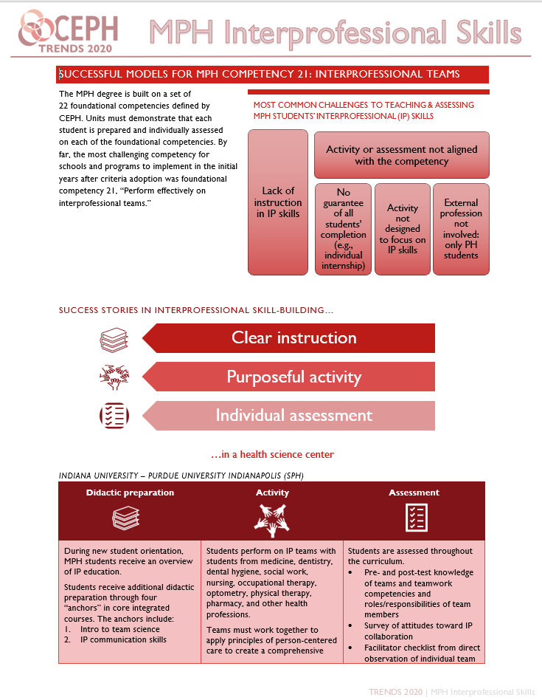
Vignettes & case studies

Slide 53
Thank you!

Slide 54
REMINDER ON QUESTIONS
We CAN provide
We CAN’T provide
Clarifications on anything you hear in the webinar
Info beyond the scope of the presentation

Slide 55
Reminder: accessing the information
What? | When? | Where?
Trends documents | 3:30 pm ET 11/10/20 | www.ceph.org/trends2020
Slides & webinar recording | 12:00 pm ET 11/11/20 | https://ceph.org/constituents/schools/faqs/pres/

