Slide 1
Thank you for joining us
The webinar will begin soon!

Slide 2
2021 Criteria for SPH & PHP

Slide 3
Logistics
Up to 1.0 CPH recertification credit
Slides & recording on website within 24 hours
FAQs and Webinars page

Slide 4
Access this and past presentations

Slide 5
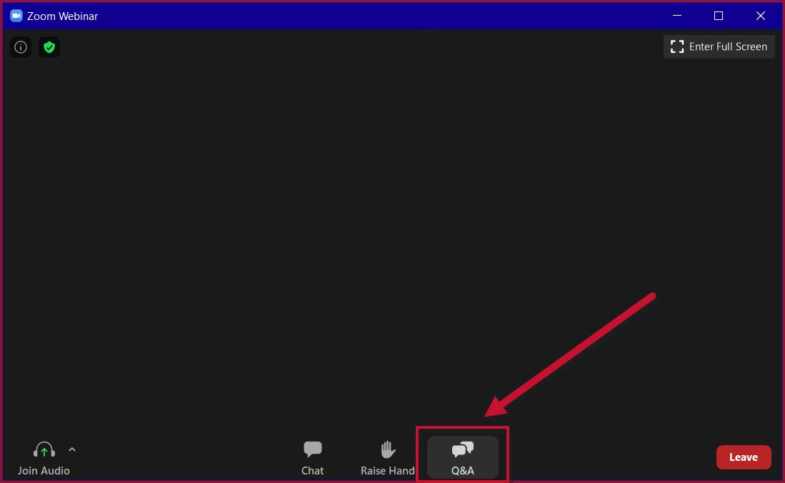
Questions & Accessibility
All questions should go in Q&A, not in chat. We don’t want to miss your question!
1.Click on cc Live Transcript
2. Select Show Subtitle.

Slide 6
Scope of revisions
SPH & PHP only
SBP Criteria unchanged

Slide 7
Scope of revisions

Slide 8
Nothing new!
If you called us to clarify any of these areas, this is the guidance you would have received!
Now written down for everybody's benefit!

Slide 9
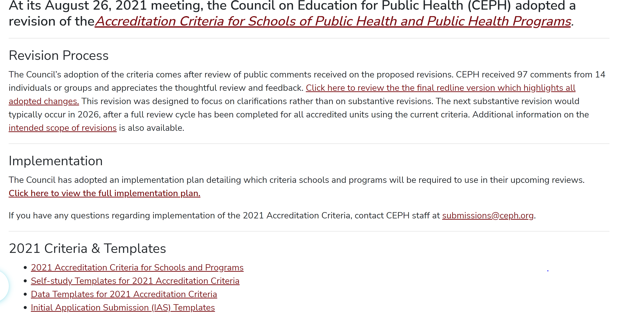

Slide 10
Implementation: accredited units
SV in… | Review will use…
2021 | 2016 Criteria
Jan – June 2022 | 2016 Criteria
Sept – Dec 2022 | 2016 or 2021 Criteria*
2023 | 2021 Criteria
* Must request 2021 Criteria in writing by 11/1/21

Slide 11
Implementation: current applicants
SV in… | Review will use…
2021 | 2016 Criteria
Jan – June 2022 | 2016 Criteria
Sept – Dec 2022 | 2016 or 2021 Criteria*
2023 | 2016 or 2021 Criteria**
** 2016 criteria allowed only for those with:
IAS accepted before Aug 2021
Current schedule maintained—no new extensions

Slide 12
Implementation: everything else
All IAS use 2021 criteria (limited exceptions)
Sub change forms use 2021 criteria
Interim reports—criteria communicated in letter
“Least restrictive” standard

Slide 14
Only one substantive (-ish) change

Slide 15
OLD Foundational competency 21
Perform effectively on interprofessional teams

Slide 16
NEW competency 21
Integrate perspectives from other sectors and/or professions to promote and advance population health

Slide 17
Notes on new FC 21
Requires direct engagement (in-person or online) between student & individual(s) outside PH
Combine external sector/profession’s perspective with PH training to complete a task, solve a problem, etc.
Role-playing, where PH students pretend to assume the external sector/profession role, NOT sufficient
All activies currently deemed compliant will continue to be acceptable!

Slide 18
Implications for accredited units
If your FC #21instruction and assessment was already accepted as compliant by CEPH, you can keep it!
If you want to change your assessment activity for FC 21, you can!
Sub change form required
Check in with staff liaison for feedback if unsure

Slide 20
Clarity for other foundational comps
Condensed without affecting meaning
Added footnotes clarifying commonly misunderstood areas
Our rec for all: download new D2 & D3 templates!

Slide 21
FC 10
Explain basic principles and tools of budget and resource management¹³
¹³ “Resource management” refers to stewardship (planning, monitoring, etc.) of resources throughout a project, not simply preparing a budget statement that projects what resources will be required

Slide 22
All competencies
Must assess individuals within group assignments
Must be assessed prior to MPH ILE & not primarily through individual internships
Expectations on documentation in ERF (i.e., may need more than the syllabus)

Slide 23
Concentration competencies
“Concentration” denotes appropriate depth of coursework & distinguishes degree offering from others in unit
Generally requires at least 9 didactic credits in 42-credit curriculum (~20% of total credits)
When units offer more than one concentration, comps taught / assessed in conc-specific courses (not core/foundational courses)

Slide 24
Concentration competencies
Offering a concentration signals that students complete sufficient depth of coursework to warrant awarding a degree in the designated field (~9 credits)
If unit doesn’t define uniform requirements to achieve this depth, concentration is “individually defined”
Advisor & student identify courses, comps & assessments for individual student’s plan of study

Slide 25
MPH APE
Practical, applied work products produced for site’s use & benefit
Review based on at least 2 non-academic work products linked to comps
“Reflection papers, contact hour logs, scholarly papers prepared to allow faculty to assess the experience, poster presentations, and other documents required for academic purposes may not be counted toward the minimum of two work products”

Slide 26
MPH ILE
“…demonstrating synthesis and integration requires more than one foundational & one concentration competency”

Slide 27
Criterion B

Slide 28
Putting the feedback loop back together
Former criteria B5 & B6 combined
New criterion tells you what data must be collected!
All data required for specific criteria AND
What other data do you need to measure YOUR specific mission & goals?
Examples of changes with indication of which data point(s) led to changes

Slide 29
B Criteria reorganized
2016 | 2021
B1: Guiding statements | B1: Guiding statements
B2: Grad Rates | B2: Eval & QI
B3: Post-Grad Outcomes | B3: Grad Rates
B4: Alumni Perceptions | B4: Post-Grad Outcomes
B5: Data Collection | B5: Alumni Perceptions
B6: Data Use | ----

Slide 30
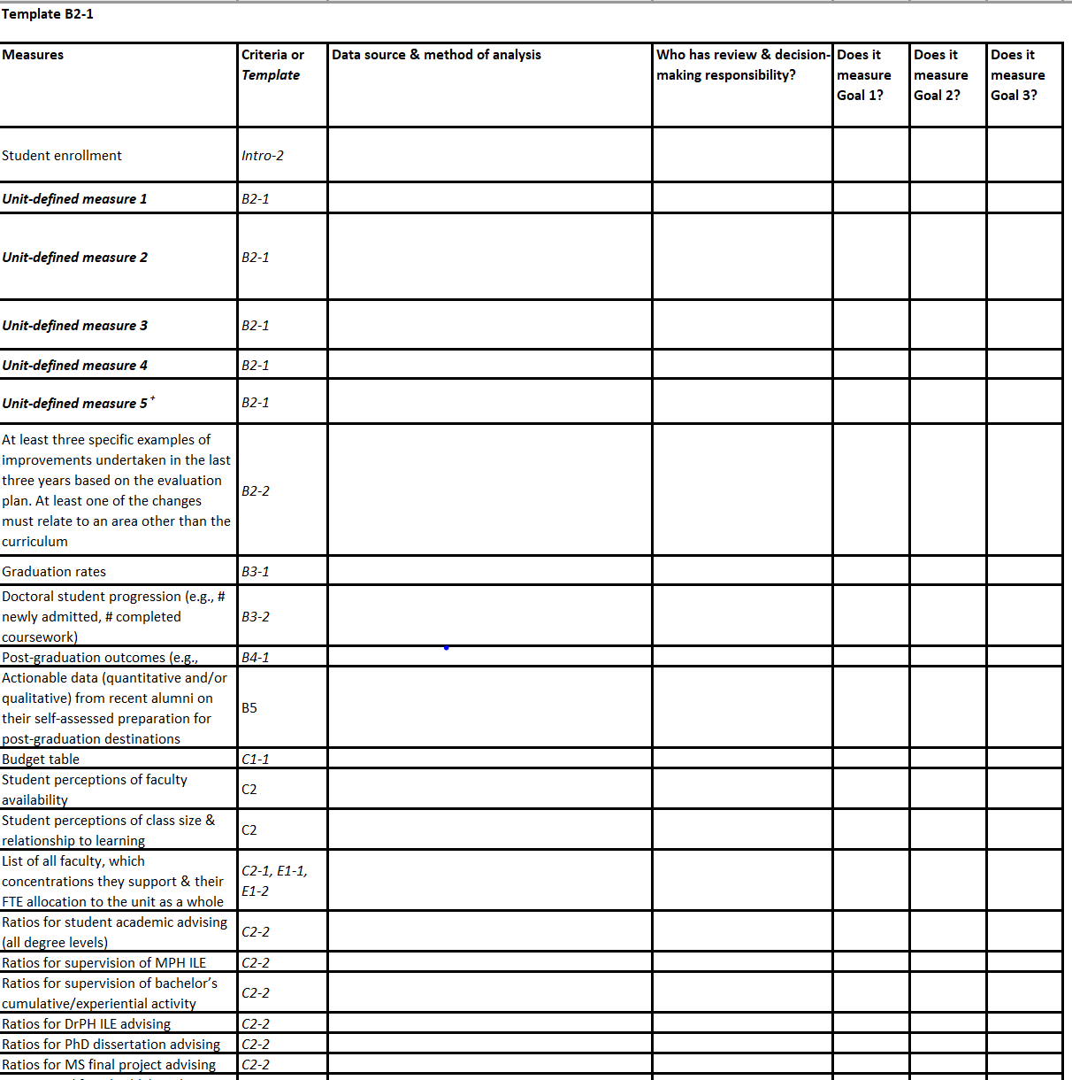
Template B2-1

Slide 31
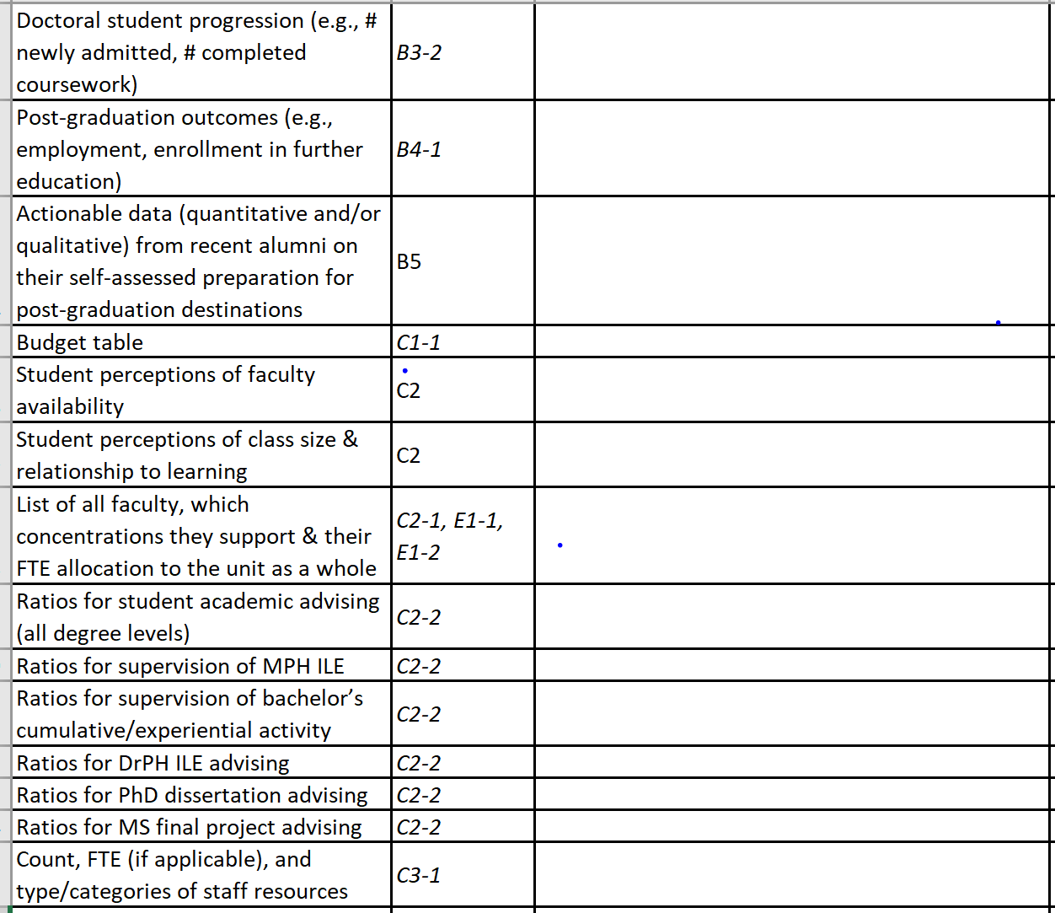

Slide 35
The unit…
“defines a process to engage in regular, substantive review of evaluation findings, as well as strategic discussions about their implications”

Slide 36
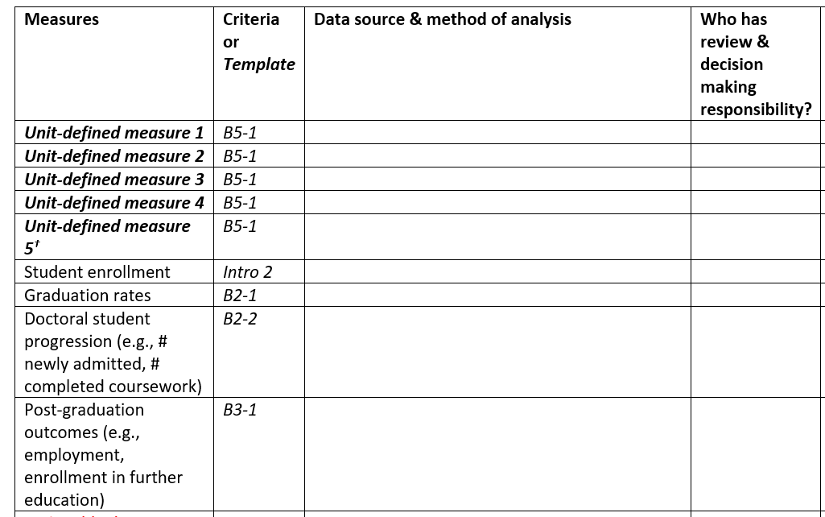
Continued focus on HOW and WHO?
HOW?
WHO?

Slide 37
The evaluation plan…
allows the school or program to make data-driven quality improvements e.g., in curriculum, student services, advising, faculty functions, research and extramural service, and operations, as appropriate

Slide 39
Alumni data streamlined & refocused
Perceptions of preparation for workforce or further education
what skills are most useful and applicable?
areas in which they feel well prepared
areas in which they would have benefitted from more preparation
Emphasis on useful data

Slide 40
F Criteria Streamlining

Slide 41
Combined F3 & F4
Emphasis on provision of continuing ed, rather than mechanics of data collection
List events, # of workforce attendees & explain how events are designed for professional community’s needs

Slide 42
Streamlined F1 areas for stakeholder feedback
content of public health curricula, relevance to current practice & future directions
development of guiding statements & eval plan & development of self-study
employers’ assessments of program graduates’ preparation for post-graduation destinations

Slide 43
Bachelor’s Curriculum Streamlining

Slide 44
Combined & condensed D9 & D10
Folded in with PH domains | Removed
Basic statistics | Social & behavioral sciences*
Biological & life sciences | Humanities
Key “general education” domains folded in with PH domains
*already encompassed in existing PH domains

Slide 45
Q&A

