Slide 1
Webinar: Teaching Leadership & Management
March 2023

Slide 2
Logistics
Up to 1.0 CPH recertification credit
Slides & recording on website within 24 hours

Slide 3
Access this and past presentations

Slide 4
Leadership and Management Skills for Public Health Students
March 10, 2023

Slide 5
Introductions
Ross Brownson, PhD Steven H. and Susan U. Lipstein Distinguished Professor | Angela Hobson, PhD, MPH Associate Dean for Public Health, Teaching Professor | Ragini Maddipati, MSW, MPH Assistant Dean for Academic Programs, Assistant Teaching Professor | Sarah Moreland-Russell, PhD Associate Professor of Practice

Slide 6
Leadership and Management Skills for MPH Students
Outline:
Scholarship on Leadership Skills for Implementation and De-Implementation in Public Health Practice
Leadership Model at Washington University in St. Louis, Brown School
Framework
Curriculum and Competency Assessments
Student and Alumni Perceptions of Competence
Lessons learned and thinking toward the future

Slide 7
Implementation and Mis-implementation defined
'implementation' refers to the process of putting a decision or plan into effect; execution
‘mis-implementation’ refers to public health decision-makers ending effective activities prematurely or continuing ineffective ones
Barriers and facilitators of 'implementation' and 'mis-implementation' in public health
Brownson RC. et al. , Understanding mis-implementation in public health practice, Am J Prev Med, 2015;48: 543-51.

Slide 8
Mis-Implementation and importance to Public Health programming
Preventing program mis-implementation is necessary to sustain public health efforts and resources needed to improve health and well-being.
Public health leaders are often responsible for making or implementing decisions such as approving or disapproving the continuance of a program.
Understand the competencies of public health leaders can help in preventing program mis-implementation.
Sarah Moreland-Russell, et al., Leading the way: competencies of leadership to prevent mis-implementation of public health programs, Health Education Research, Volume 37, Issue 5, October 2022, Pages 279–291, https://doi.org/10.1093/her/cyac021

Slide 9
The Public Health Leadership Competency Framework
Czabanowska, Katarzyna, et al. "In search for a public health leadership competency framework to support leadership curriculum–a consensus study." The European Journal of Public Health 24.5 (2014): 850-856.

Slide 10
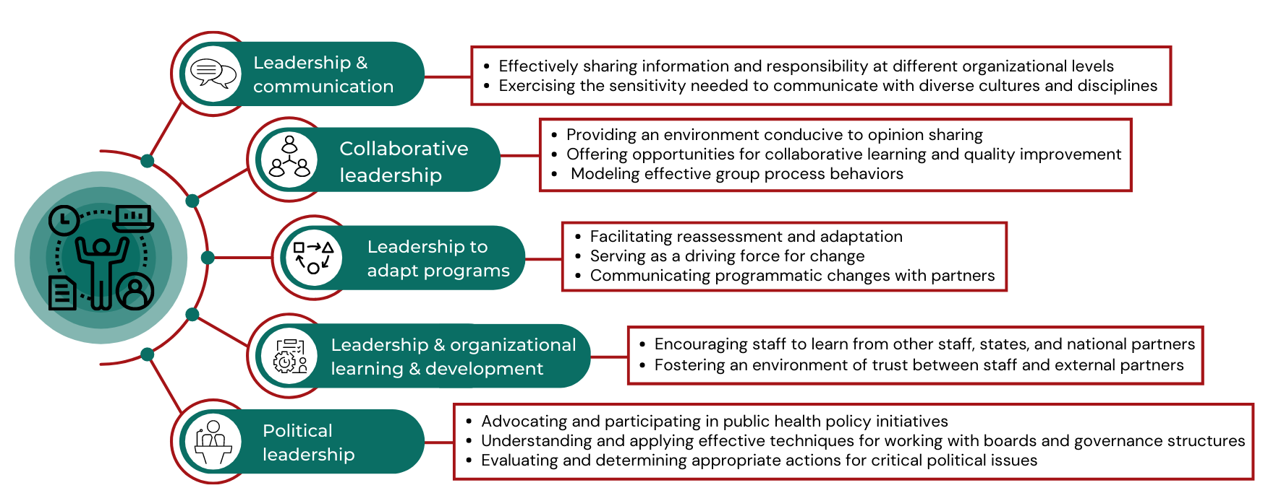
Competencies of Leadership to Prevent Mis-Implementation
Sarah Moreland-Russell, et al., Leading the way: competencies of leadership to prevent mis-implementation of public health programs, Health Education Research, Volume 37, Issue 5, October 2022, Pages 279–291, https://doi.org/10.1093/her/cyac021

Slide 11
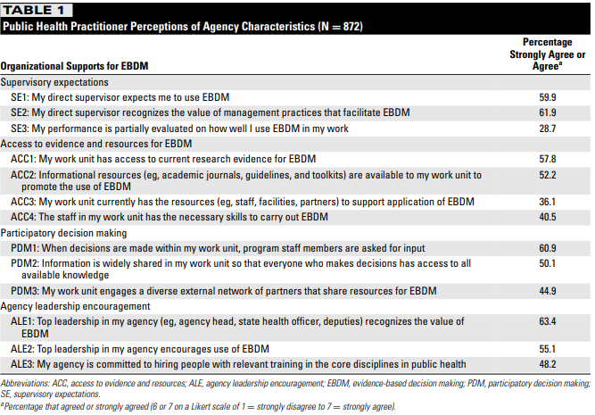
Parallel literature on core leadership attributes in PH agencies
Hu H, Allen P, Yan Y, Reis RS, Jacob RR, Brownson RC. Organizational Supports for Research Evidence Use in State Public Health Agencies: A Latent Class Analysis. J Public Health Manag Pract. Jul/Aug 2019;25(4):373-381.

Slide 12
Leadership at the Brown School
85
Per cohort
45% International
75%
Female
24 y
Median Age
55% Domestic SOC
Context: Public Health Program within a School of Social Work
Degree programs:
Masters: Social Work, Public Health, Public Policy
Doctorate: Social Work, Public Health
MPH Students

Slide 13
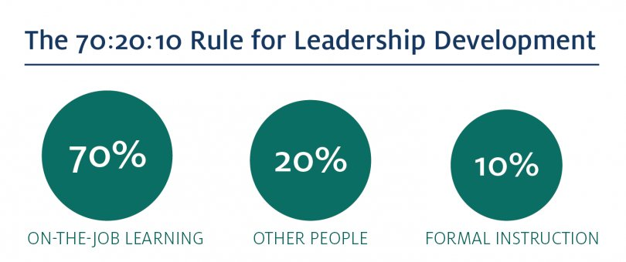
Leadership at the Brown School
Public Health, Social Work, and Social Policy → shared values and goals
Mental Model of Leadership → Often a barrier
Leadership at Brown Monograph
Lead author, Barry Rosenberg, MSW
Incorporated into multiple curricular venues
Image: Center for Creative Leadership

Slide 14
Leadership at the Brown School
Leadership Defined:
Leadership is the process of influencing the values, beliefs, attitudes, commitments and behavior of others in pursuit of shared goals. It is about bringing about some type of change within groups, teams, organizations, communities, government or the society-at-large. It is about setting a direction for the future.
Principles and Distinctions
1. Authority is not synonymous with leadership
2. Leading is behavioral
3. Leadership is related to but different from management
4. Leadership comes through social interaction
5. Leadership must have followership – a type of leadership itself
A detailed discussion of the nature of leadership which outlines and distills these concepts in more detail is available in the highly respected work of Gary Yukl.

Slide 15
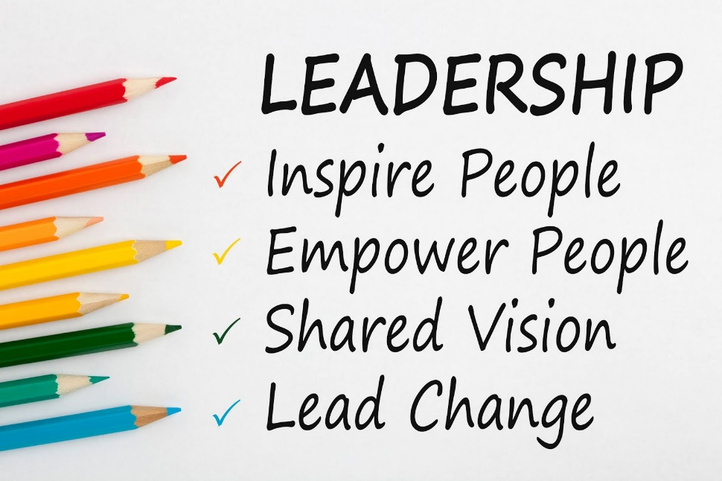
MPH Curriculum and Leadership – 1st and 2nd Semester Sequence
Cross Cutting Themes in Public Health
Leadership at Brown Reading
Leadership Panel
Public Health Seminar (PHS) II
Classic to Contemporary Cases in Public Health
Readings, Discussions, Practice Activities, and Assessments:
Leadership Development
Stakeholder Analysis
Negotiation and Conflict Management Skills in Public Health
Other Required and Elective Courses (throughout program)

Slide 16
PHS: Self-Assessment and Reflection in Leadership Development
Viewing Oneself as a Leader
Critical before practicing leadership and management competencies
Pre-Competency assessment activities:
Leadership values exercise
Self-assessments – Personality/Leadership styles, Influence Tactics Inventory, Conflict Management Style
Leadership Self- Reflection Paper
Narrative, Purpose, Vision
Leadership Style
Alignment with Course Content

Slide 17
CEPH Competencies
MPH Foundational Leadership Competencies
16. Apply leadership and/or management principles to address a relevant issue
17. Apply negotiation and mediation skills to address organizational or community challenges

Slide 18
PHS Leadership Competency Assessment
Leadership Case Analysis Paper
Purpose: Demonstrate critical thinking around leadership, vision, negotiation, and communication to solve an adaptive public health challenge
Implement Mental & Behavioral Health Program for Latino/Latina/Latinx youth
Adapted from: Acosta Price, O; Fishman, J; Chapman, M. Building on Strengths: A school-based mental health program. Essential Case Studies in Public Health (pp.81-88). January 2011. Editors: K.L. Hunting & B. L. Gleason, Jones and Bartlett Learning, Sudbury MA
Acting as Assistant Director for Division of Behavioral Health, City Department of Health – with many competing budget priorities and an outgoing Director

Slide 19
PHS Leadership Competency Assessment cont.
Leadership Case Analysis Paper cont.
Components:
Vision for Change
Stakeholder Analysis
Strategy for Gaining Approval – collaboration and negotiation
Message Framework
Assessed on:
Comprehensive justifications for stakeholders
Substantive leadership strategy, including sequencing of approach
Clear vision for change, message framework and talking points are concise and relevant

Slide 20
PHS Leadership Competency Assessment cont.
Strengths:
Real-world example where leadership skill is needed to influence change within an organization and in a community
Vision for change and stakeholder analysis
Collaboration and Negotiation – have improved over time
Struggles:
Collaboration and Negotiation
Sequencing of Strategy – sometimes misses the mark
E.g. – Go straight to the Mayor, Forget to involve key stakeholders.

Slide 21
MPH Competency Student Self-Assessment
Students complete a self-assessment of the CEPH foundation competencies in their first semester and final semester of the program.
The two foundational leadership competencies:
Apply principles of leadership, governance and management, which include creating a vision, empowering others, fostering collaboration and guiding decision making.
Apply negotiation and mediation skills to address organizational or community challenges.
Students are asked to rate their competency as:
Not at all competent
Slightly competent
Average competency
Competent
Highly competent
Complete pre- and post-assessment data for 174 students from 2018-2022*.
*Implementation of new CEPH competencies

Slide 22
Leadership competency: Apply principles of leadership, governance and management, which include creating a vision, empowering others, fostering collaboration and guiding decision making (n = 174)
*Statistically significant difference, p<0.05, 95% CI

Slide 23
Leadership competency: Apply negotiation and mediation skills to address organizational or community challenges
*Statistically significant difference, p<0.05, 95% CI

Slide 24
MPH Alumni Survey
We conducted a survey of our MPH alumni in 2022, which included alumni from 2016-2021.
The survey asked alumni to indicate their preparedness for the CEPH Foundational and program Specialization competencies.
For each competency, alumni were asked to indicate their level of agreement to the question: “After graduating from the Brown School with an MPH degree, I was prepared to:”
We combined the leadership competencies into one statement:
Apply leadership and management skills, including negotiation, in an organization or community.
Response choices included:
Completely agree
Agree
Disagree
Completely Disagree
Not sure
We received a total of 162 responses from June 2022 – August 2022.

Slide 25
Apply leadership and management skills, including negotiation, in an organization or community (n = 162)
*Leadership at Brown implemented in 2019

Slide 26
Apply leadership and management skills, including negotiation, in an organization or community
*Leadership at Brown implemented in 2019

Slide 27
Lessons Learned and Future Thinking
Leadership skill development is imperative for public health students
Students often have barriers – real and perceived – to viewing themselves as leaders
Intentional leadership development and CEPH competencies in curriculum increases student perceptions of skill. However….
Leadership self-reflection is key to development and likely necessary before assessing competence.
We largely focus on implementation → room for critical exploration on leadership in de-implementation.
Unknown: What are barriers to alumni perceptions of skill?
What are their opportunities for leadership self-reflection, development, and skill building overtime?

